Slide 1
Introduction to Computer Graphics with WebGL
Ed Angel
Professor Emeritus of Computer Science
Founding Director, Arts, Research, Technology and Science Laboratory
University of New Mexico
Angel and Shreiner: Interactive Computer Graphics 7E © Addison-Wesley 2015

Slide 2
Meshes
Ed Angel
Professor Emeritus of Computer Science
University of New Mexico
Angel and Shreiner: Interactive Computer Graphics 7E © Addison-Wesley 2015

Slide 3
Objective
Introduce techniques for displaying polygonal meshes
Angel and Shreiner: Interactive Computer Graphics 7E © Addison-Wesley 2015

Slide 4
Meshes
Polygonal meshes are the standard method for defining and displaying surfaces
  Approximations to curved surfaces
  Directly from CAD packages
  Subdivision
Most common are quadrilateral and triangular meshes
  Triangle strips and fans
Angel and Shreiner: Interactive Computer Graphics 7E © Addison-Wesley 2015

Slide 5
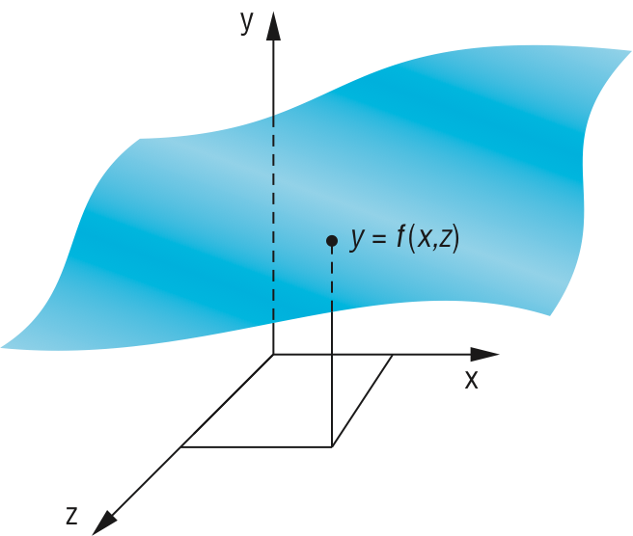
Height Fields
For each (x, z) there is a unique y
Sampling leads to an array of y values
Display as quadrilateral or triangular mesh using strips
Angel and Shreiner: Interactive Computer Graphics 7E © Addison-Wesley 2015

Slide 6
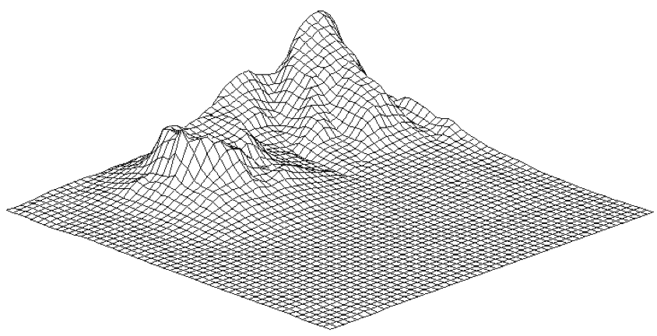
Honolulu Plot Using Line Strips
Angel and Shreiner: Interactive Computer Graphics 7E © Addison-Wesley 2015

Slide 7
Plot 3D
Old 2D method uses fact that data are ordered and we can render front to back
Regard each plane of constant z as a flat surface that can block (parts of) planes behind it
Can proceed iteratively maintaining a visible top and visible bottom
  Lots of little line intersections
Lots of code but avoids all 3D
Angel and Shreiner: Interactive Computer Graphics 7E © Addison-Wesley 2015

Slide 8
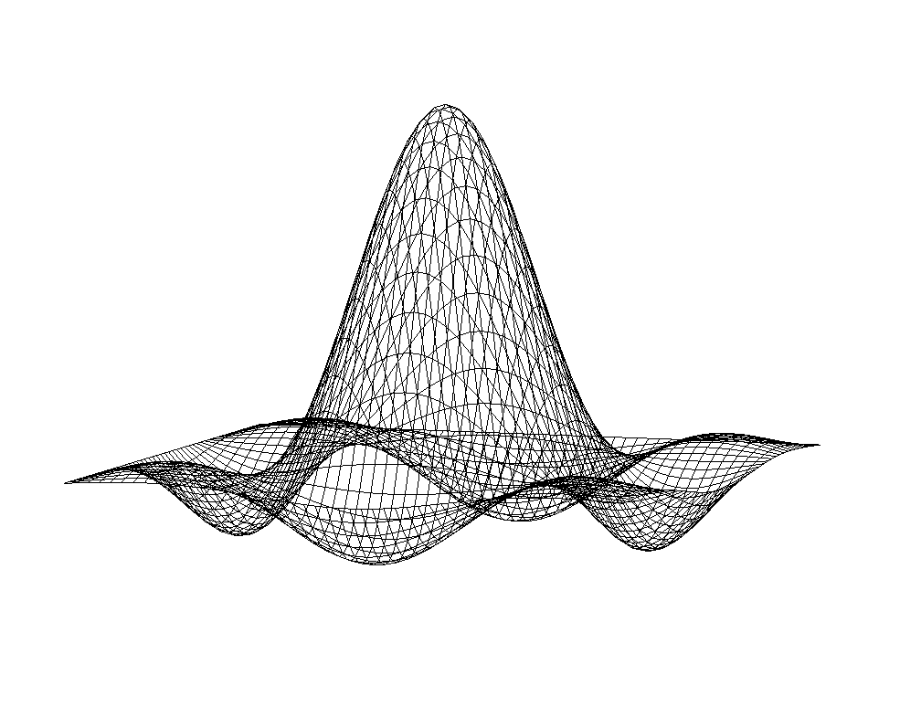
Lines on Back and Hidden Faces
sombrero or Mexican hat function (sin πr)/(πr)
Angel and Shreiner: Interactive Computer Graphics 7E © Addison-Wesley 2015

Slide 9
Using Polygons
We can use four adjacent data points to form a quadrilateral and thus two triangles which can be shaded
But what if we want to see the grid?
We can display each quadrilateral twice
  First as two filled white triangles
  Second as a black line loop
Angel and Shreiner: Interactive Computer Graphics 7E © Addison-Wesley 2015

Slide 10
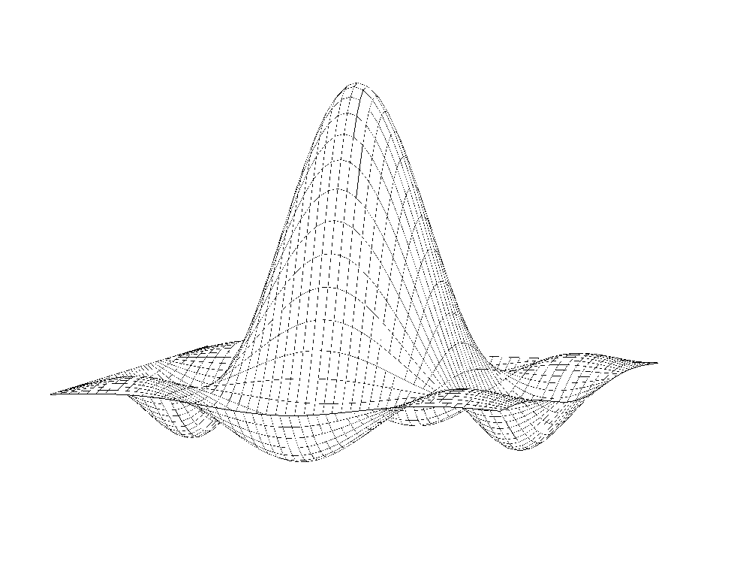
Hat Using Triangles and Lines
Angel and Shreiner: Interactive Computer Graphics 7E © Addison-Wesley 2015

Slide 11
Polygon Offset
Even though we draw the polygon first followed by the lines, small numerical errors cause some of fragments on the line to be display behind the corresponding fragment on the triangle
Polygon offset (gl.polygonOffset) moves fragments slight away from camera
Apply to triangle rendering
Angel and Shreiner: Interactive Computer Graphics 7E © Addison-Wesley 2015

Slide 12
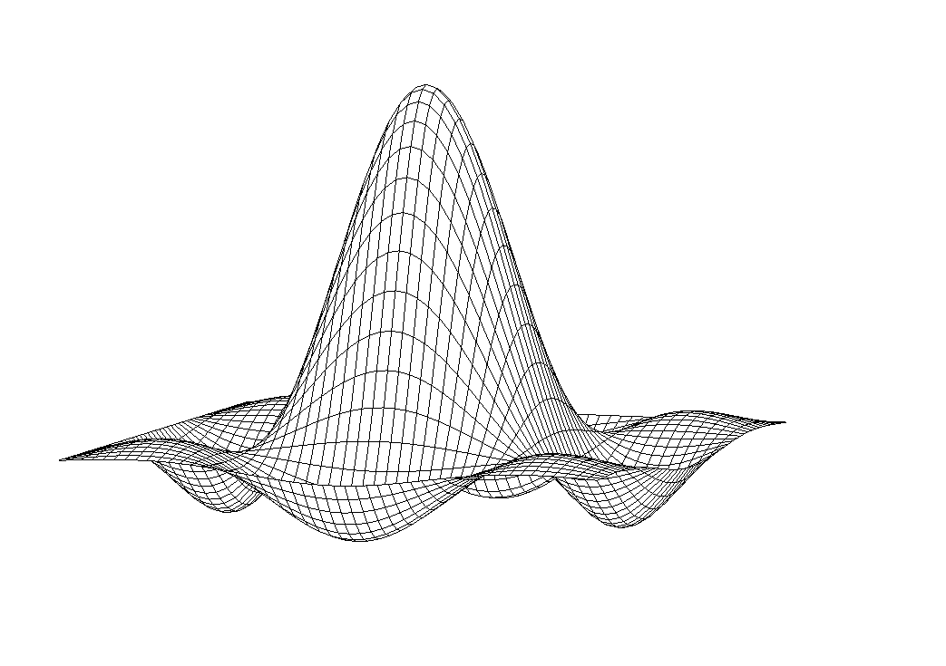
Hat with Polygon Offset
Angel and Shreiner: Interactive Computer Graphics 7E © Addison-Wesley 2015

Slide 13
Other Mesh Issues
How do we construct a mesh from disparate data (unstructured points)
Technologies such as laser scans can produced tens of millions of such points
Chapter 12: Delaunay triangulation
Can we use one triangle strip for an entire 2D mesh?
Mesh simplification
Angel and Shreiner: Interactive Computer Graphics 7E © Addison-Wesley 2015

